Slide 1
Fundamental Programming Structure
Rajasekaran. S
Assistant Professor
Dept of IT

Slide 2
First Java Program Say Hello to World
import java.io.*;
public class Main {
public static void main(String[] args){
System.out.println(“Hello World”);
}
}

Slide 3
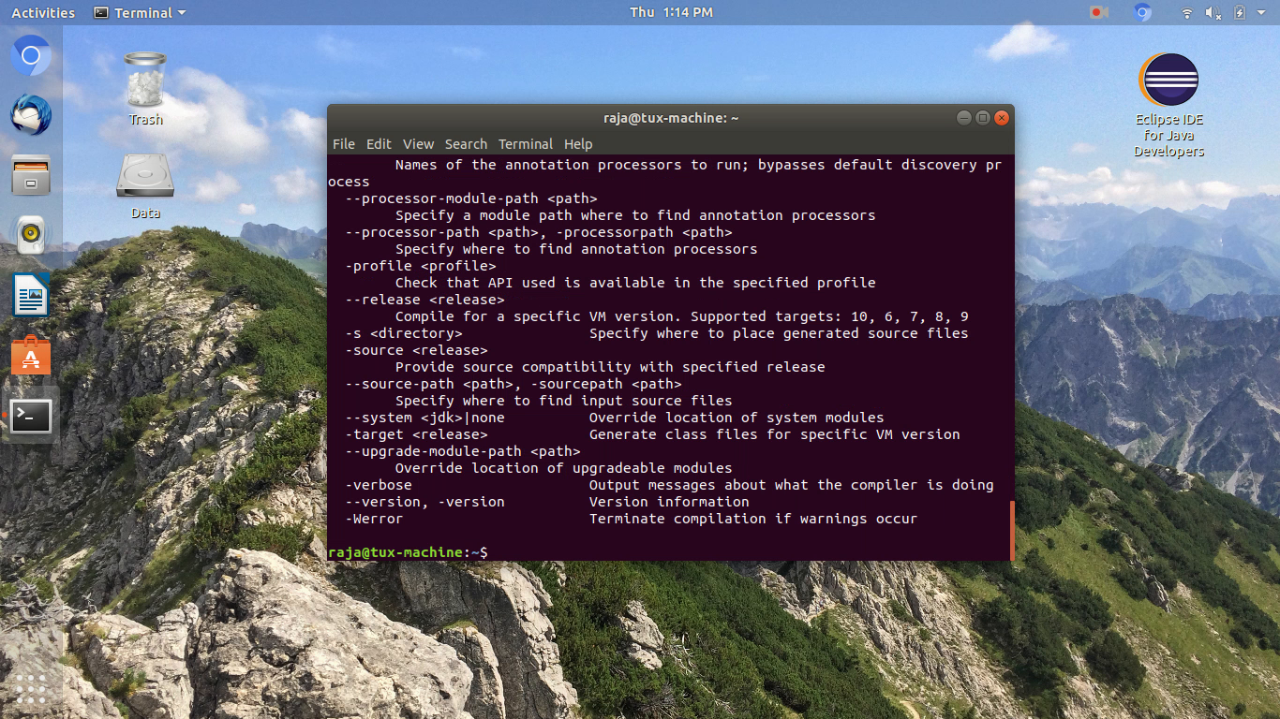
Checking for Java and Javac

Slide 4
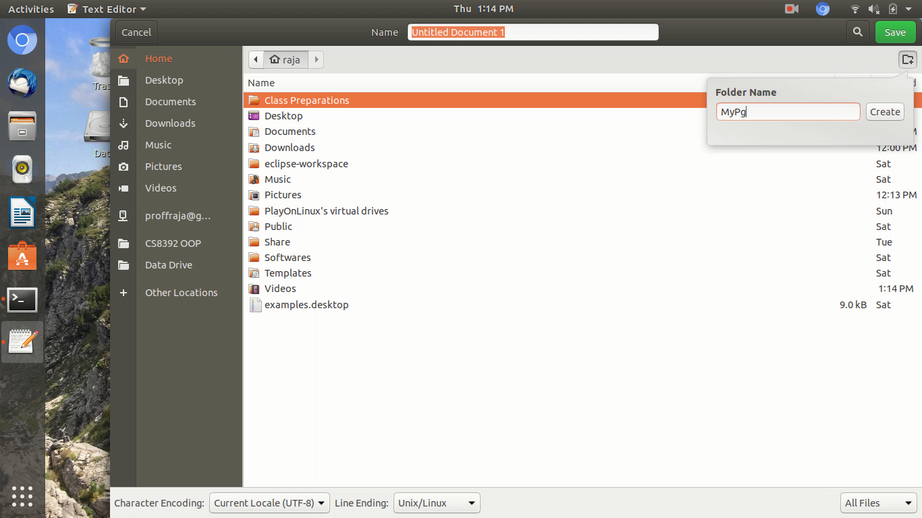
Creating Folders for My Program

Slide 5
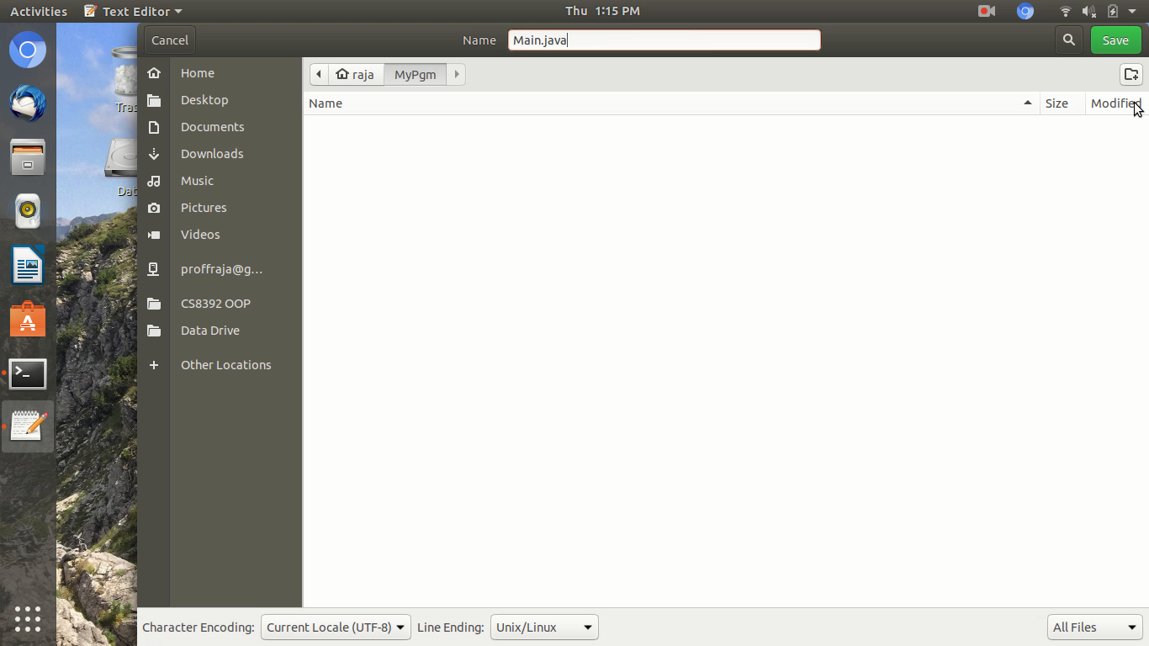
Rule 1: File name must resemble class name.
Saving File as Main.java

Slide 6
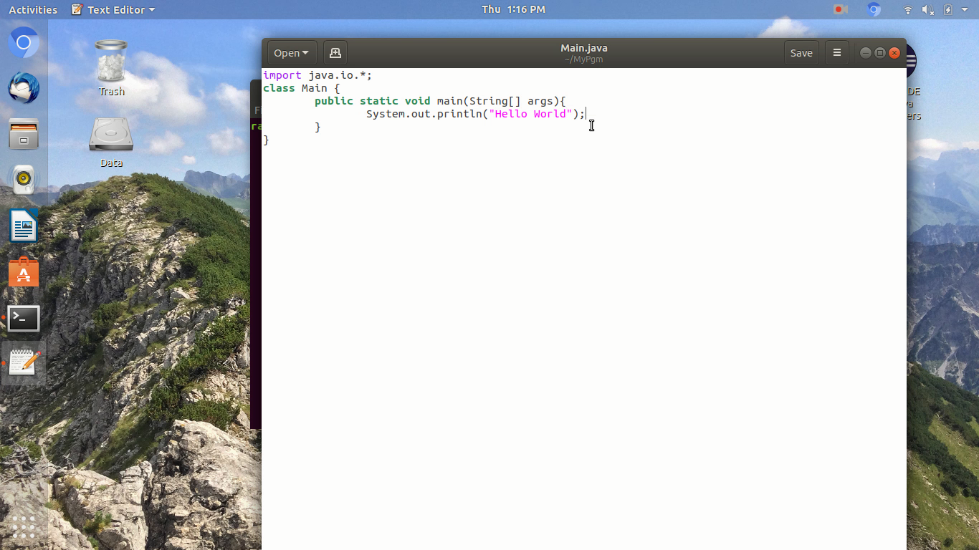
Creating Your First Program

Slide 7
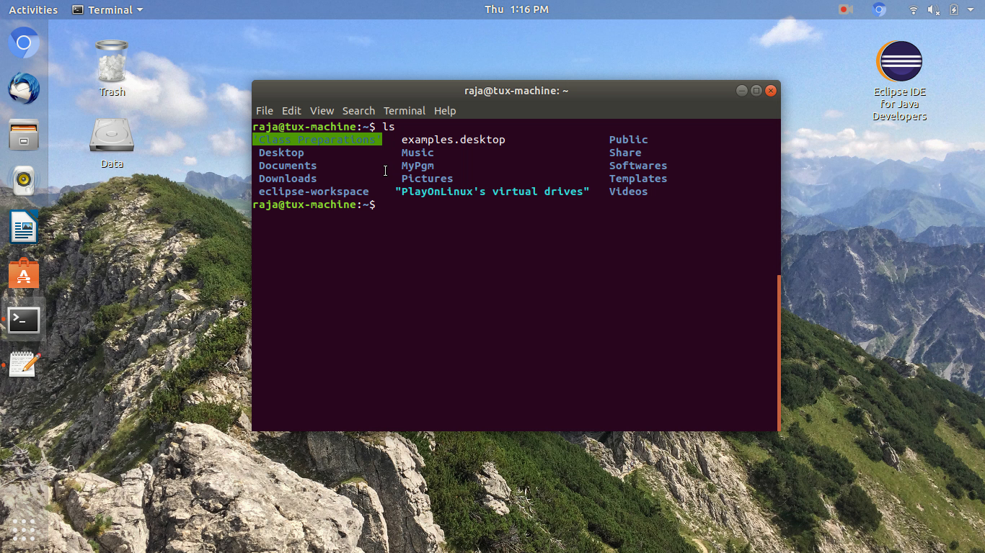
Navigate to Your Program Folder

Slide 8

javac Main.java
Compiling Main.java

Slide 9
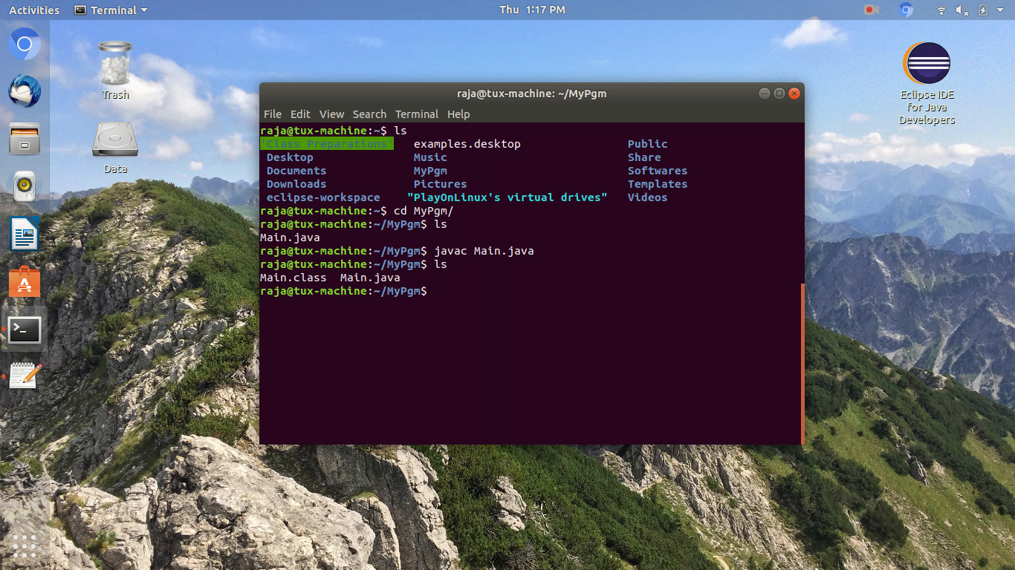
What is Main.class ?

Slide 10

java Main
Done

Slide 11
https://youtu.be/rrrWZXbMuUw
Live Demo

Slide 12
Java Comments
It is a programmer-readable explanation or annotation in the source code of a computer program.
It help’s to understand the source code.
It is ignored by compilers and interpreters.

Slide 13
How to Comment in Java?
import java.io.*;
public class Main {
public static void main(String[] args){
System.out.println(“Hello World”);
}
}
//This will print hello world in console;
Single Line Comment

Slide 14
How to Comment in Java?
import java.io.*;
public class Main {
public static void main(String[] args){
System.out.println(“Hello World”);
}
}
/*
*@author Rajasekaran S
*@version 1.0
*Program Says hello to the world
*/
Multi Line Comment
//This will print hello world in console
Single Line Comment

